Slide 1
Iteration 3
The Three Amigos

Slide 2
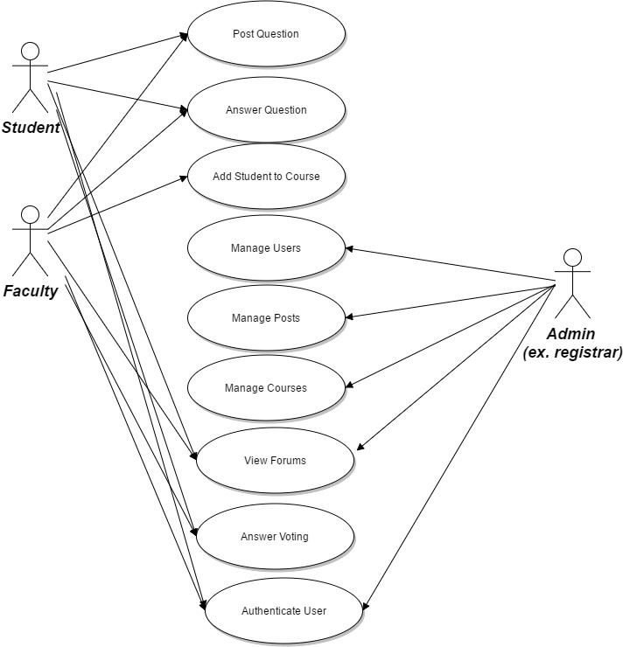
Final Use
Case Model

Slide 3
Changes during this Iteration
Bug fixes
Usability features
Pagination and filtering
Search questions option
Links between user profiles and course pages

Slide 4
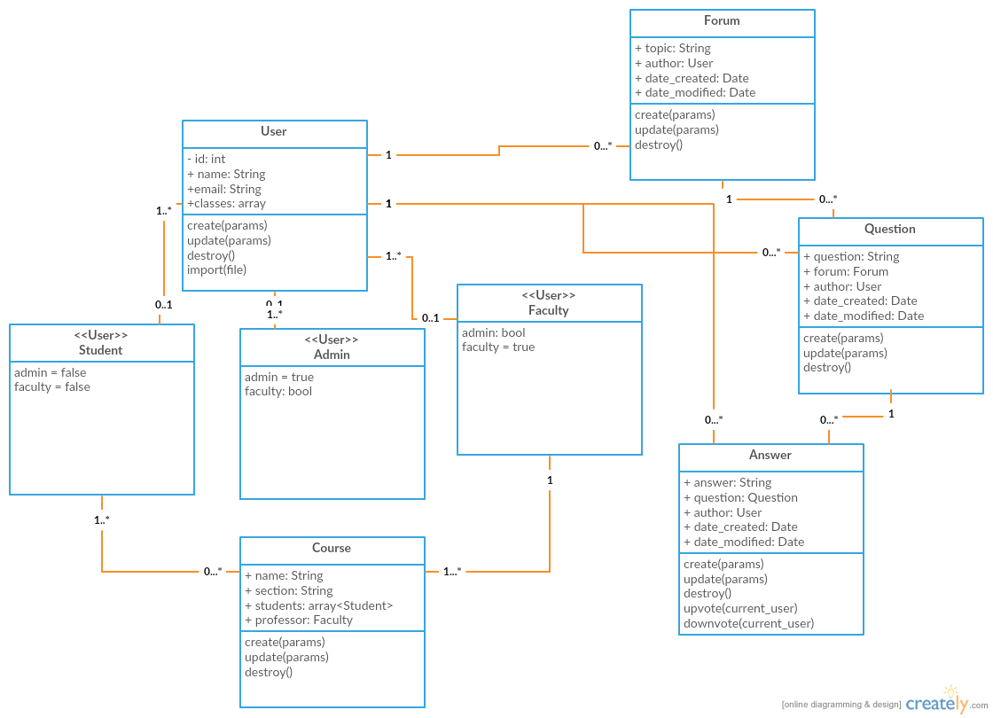
Design

Slide 5
Test Plan
Tests based on use case model
Project tests
Integration tests

Slide 6
Demo
https://mighty-anchorage-84460.herokuapp.com/

